Slide 1
The impact of COVID-19 on people's travel by air
Presented by:
Rui Chen, Yutai Li, Yuming Wang, Boning Zhang

Slide 2
Data issues & cleanliness
Covid-19 cases dataset:
wrong types, missing values
Opensky Airline dataset:
missing values
Tweets related to Covid and flight
missing values, noise values
Notes:
Hi I am Boning, I am gonna start with data issue and data cleanliness. For the covid-19 cases, the problems are wrong types. (different data types in one column for example there are both string and numeric data in date attribute) also missing values (due to some reasons) same things happened in Opensky dataset and in tweets dataset, we also found noise values which are stopwords, emojis

Slide 3
Data pre-processing
Covid-19 cases dataset & Opensky Airline dataset:
Check duplicates & handle missing values
Tweets related to Covid and flight
Remove stopwords and translate emojis
Notes:
And after deep observation on dataset, the next step is data pre-processing, on covid-19 dataset, we checked and removed duplicates and handled missing values by replacing them with mean values, cause there are mathematic relationships between data attributes, and mean values makes more sense than zero values. On tweets dataset, we removed the stopwords and translated the emoji to find out what the meanings are behind emojis.

Slide 4
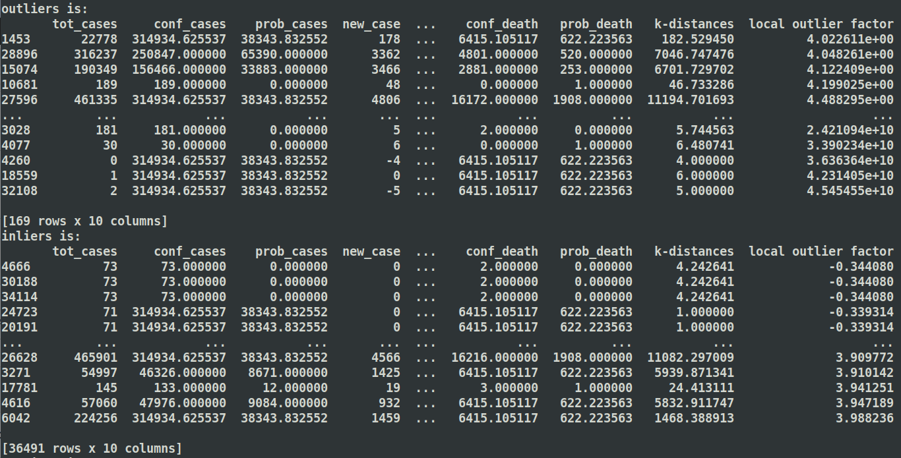
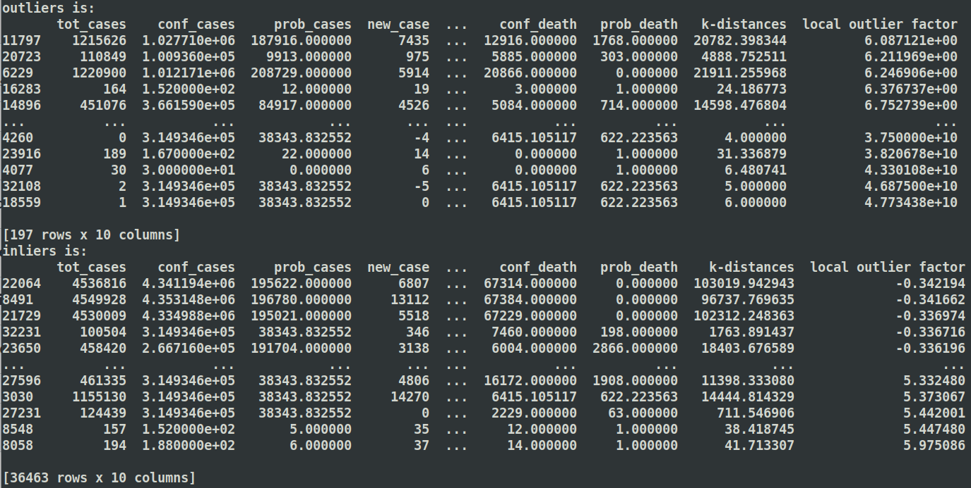
Analysis
Basic Statistical Analysis
Mean, median, mode, standard deviation
Anomalies Detection Lof algorithm
K = 5 k = 10 k = 15
Notes:
Then we began to do different kinds of analysis on dataset. We calculated mean, median, standard deviation, and even mode values of the dataset. Then we did anomaly detection on those datasets. Here we applied lof algorithm and these are three different situations of outliers when k has different values. Then yuming is gonna introduce the remaining parts of analysis on our dataset.

Slide 5
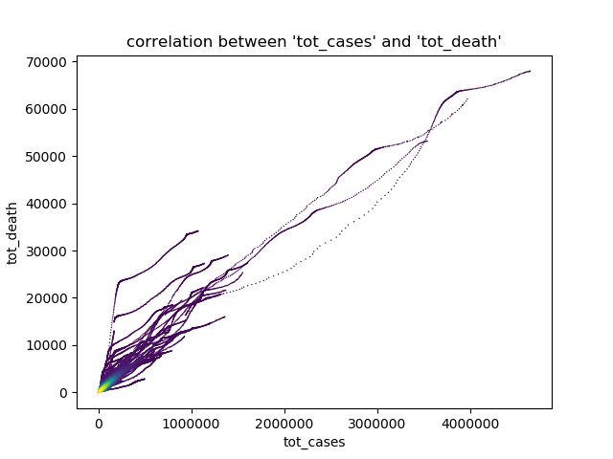
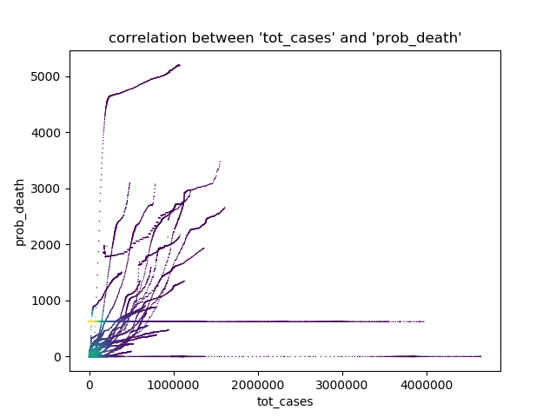
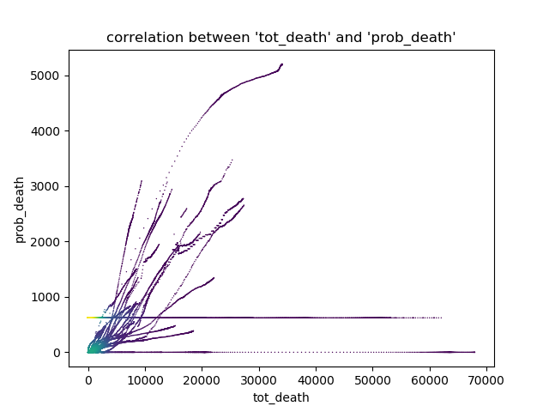
Correlations
fddsfsfff
Notes:
OK, let‘s take a look at these scatter plots And try to get the relationship between different values
第一张图：
So in the first picture, We can see that the points formed by tot_cases and tot_death present multiple curves shapes.
And by observing these shapes, we can conclude that the overall relationship between these two data is proportional.[pro pou xun nou]
In addition, we can find that the scatter points are not completely concentrated together to form a sphere [sfir] , but form multiple curves, starting from the zero point.
Such a result may reflect the relationship between the total number of diagnoses and the total number of deaths in different states, or it may be the influence of the season, which makes the image present such feature
第二张图：
In the second picture we can see that the scatter points also form many curves that are close to straight lines, instead of clustering into a cluster. The analysis of this situation is the same as the analysis in the first picture.
What is worth noteing is that there are two approximate horizontal lines in the figure.
For the below one, we can see the value of tot death for each point is 0, so it reflects that sometimes total cases has a non-negative value, but the value of probable cases is 0, which is reasonable
And for the above one, we can see one value of prob_death occurs many times, this situation is caused by filling the blank part with the average value.
The resaon for us to do that is： If we do not fill in the blank, we will lose nearly half of the data， because there are many blanks here. In addition , it is a time series data. So if we didn’t fill in the blank. Chances are that we may lose the data a long period of time, and it will be difficult to compare the data features of different time periods. For example, like the influence of seasons on the number of death in a city.
第三张图:
In the third picture, we can find that the relationship between probable_death and tot_death is very close to the relationship diagram between probable_death and tot_cases.
So the conclusion can be similiar.
Then, let’s see some histograms to find out other features of the data.

Slide 6
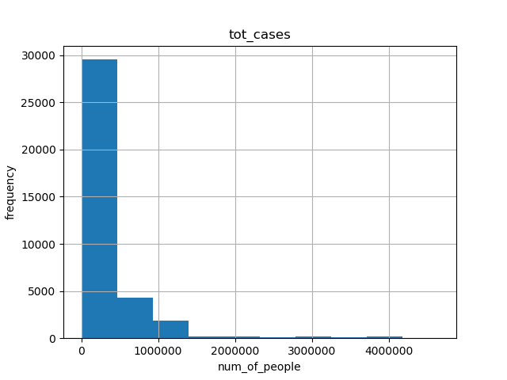
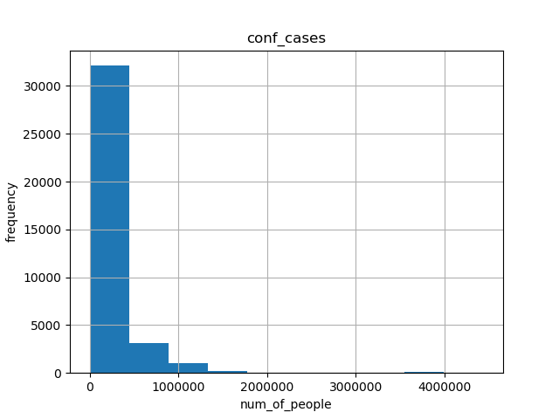
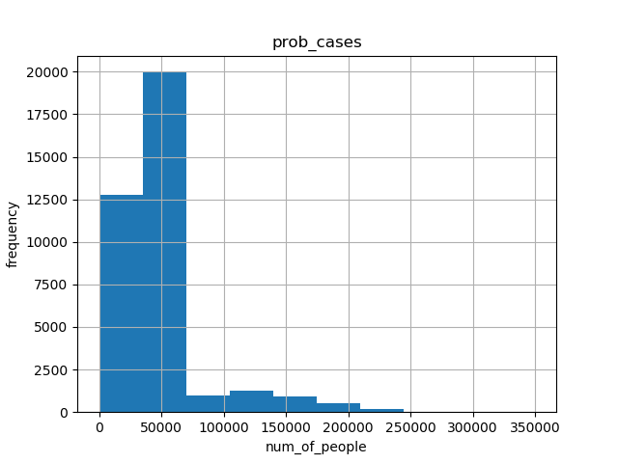
Histograms
Notes:
There are three histograms, made by using the number of total cases, the number of confirmed cases and the number of probable cases.
We can see that the histogram shapes and range of values of tot_cases and conf_cases are almost same ，which means he data distribution of these two are very similar
Since the value of tot_cases is determined by several things, of course including confirm_cases and probable cases.
We can conclude that the value of confirm_cases can be a key factor affecting the value of tot_cases. That’s what we found from the histogram
Ok，then Yutai will show will show us the results of further data analysis

Slide 7
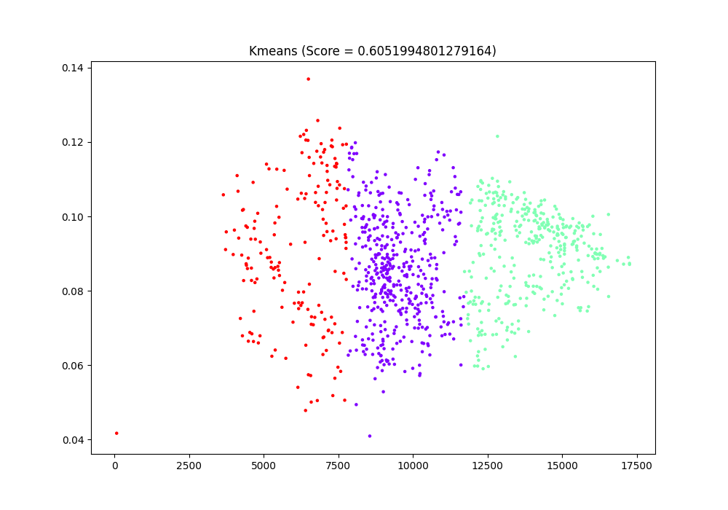
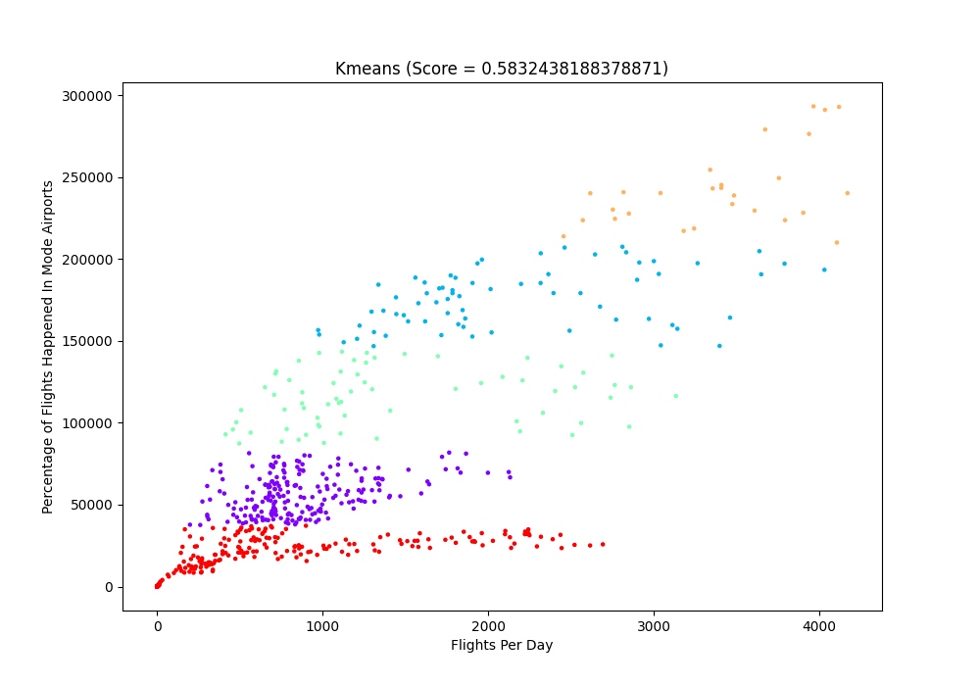
Cluster Analysis
Corresponding Dataset - Opensky & CDC
DBScan, GMM, K Mean, Ward.
Nothing meaningful found.
Important part for future work
Notes:
Here we come to the analysis part.
However, at the beginning of this part, I need to mention that because we did get enough data, we failed to find any useful information from those analyses.
First of all, Let’s take a look at the cluster analysis.
We have conducted all four cluster analyses on the opensky and CDC dataset. However, since all numeric dataset we got are time series, it’s hard to conduct the above 4 methods. So we combine several columns into columns to do the analysis. But nothing changed, even though we have made out four of them, they seem meaningless. This might be because we didn’t use those methods correctly, or we didn’t get enough data to compare with, to analyze. Which would be an important part for our future work.

Slide 8
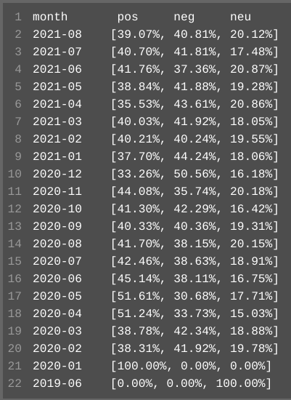
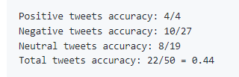
Sentiment Analysis
Corresponding Dataset - Twitter Text
‘VaderSentiment’ for grading
Poor accuracy(Correctness)
Important part for future work
Notes:
Then, it comes to sentiment analysis.
The corresponding dataset would be Twitter text dataset. We manually add tags by determining the sentiment for each twitter. However, the data we got is too messed up. So the accuracy and correctness of the analysis is pretty poor. So we choose to put this part in the future work, get more data and try more methods to analyze.
As for what we got from this analysis, Positive tweets are apparently more than negative tweets in the beginning of the pandemic. Although there are some months that negative sentiments are significantly more than positive sentiments. As time went by, tweets from people tended to be balanced between positive sentiment and negative sentiments. Which matches our hypothesis with the linear and logistic regression, that the the flights per day tend to be stable with time passed.

Slide 9
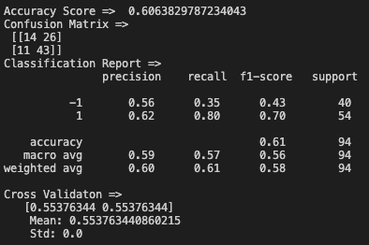
Hypothesis
Most meaningful one -
Although the number of flights per day is generally on the rise. Flights per day would still be affected by daily new cases and deaths.
Decision Tree.
Insignificant.
Notes:
Then we come to the hypothesis part.
We did about 6 hypotheses in total. But like I mentioned before, we only got two numerical dataset, and both of them are time series, so we didn’t generate much useful result.
And because of the time limitation,
As the result, we decided to choose the most meaningful one to display, which would be the hypothesis about the daily cases and deaths and flights per day.
We divided flights data into groups
When the flights number is decrease by tomorrow, mark it as '-1',
When the number of flights increases by tomorrow, mark it as '1' (If it remains the same, mark it as '0', which is impossible in our data set, so there are two groups in total.)
And then, let the decision tree do its work. To see if there is a corlection between the flights’ increment and the number of daily new case and death.
As we can see here, the info generated by the decision tree tells us there is a relation between people's mind about taking flights and daily new cases and deaths. However, those outputs also donate that the relation is so insignificant that we can assume that only a small part of people would consider the daily new cases and deaths when they are going to take a plane.
Those are what we got from the analysis, then Rui Chen will bring us the conclusion

Slide 10
Conclusions
There is no doubt that travels by air is affected by COVID-19.
People’s moods are affected by COVID-19
People are more positive in terms of travel by air at the beginning of this pandemic.
People become more negative as time went by.
Only a part of travelers are finally stopped by COVID-19
Travelers are stopped most at the beginning of this pandemic.
Travelers made up their minds as time went by.
Notes:
There is no doubt that travels by air is affected by COVID-19.
Through sentiment analysis we know that sentiment of people are unstable. They tends to be more positive at first. They might be confident and thought COVID would all ends really soon. And then they become more negative cause it didn't end at all.
By combining flights dataset with CDC dataset we know that COVID-19 did stopped people traveling, but not significantly. They are mostly stopped at the beginning of this pandemic, and as time went by, people who decided to travel by air still travel.

Slide 11
Ethical consideration & Limitations
Bias
Only airlines data included
Only US regions are considered
Tweets
It is scraped through publicly available but related to specific twitter user
It remains in our dataset even if the original user deletes it
Sentiment Analysis
Not accurate enough
Data Combinations
Text data should be somehow considered into analysis
Notes:
There are a few ethical considerations and limitations in our project.
The first thing is bias. Apparently the fact that we only discussed about airlines made our bias. We didn't take other forms of transportation into consideration mainly because they are hard to obtain. But it's still a fact that our project can do better if we can compare airlines data with trains records or some other forms.
Another bias in our project is that we only considered US regions. If we can get flights data and covid-19 cases datasets all around the world, we can then do comparison to find out to what degree covid has affect each countries.
Another ethical consideration is about our dataset of tweets. Even though it is scraped through publicly available, but it is related to specific twitter user. And this data will remains in our dataset even if that user deletes it.
As for sentiment analysis, we did come up with a few conclusions by that, but the sentiments within tweets are not accurate enough. If the accuracy of it can improve, our sentiment analysis will also be more convincing.
As for Data Combinations, Text data are solely analyzed. We didn't combine text data with other datasets when we are doing data analysis. And that the same for network analysis. We should definitely try to vectorize these text data and combine them with other forms of data and analyze them together.

Slide 12
Thank you!
Questions?

